Slide 1
Exploring History, Ecology and Sustainability of Sugarcane
Environmental sustainability
01
History
02
Ecology
Name:
Date: 1st November 2024
03
Sustainability
View Slides

Slide 2
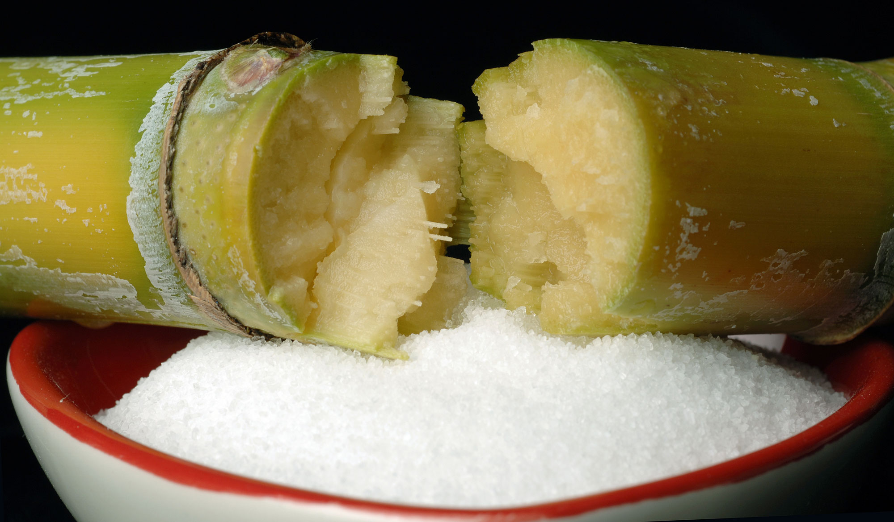
Introduction
What is Sugarcane
A tropical grass widely cultivated for sugar production.
Rich in cultural, economic, and ecological significance.
Purpose of the project
To explore the historical, ecological, and contemporary significance of sugarcane.
Notes:
Hello everyone. My presentation is about the Sugarcane, where we explore the multifaceted significance of sugarcane in our world.
Sugarcane is a tropical grass that has been widely cultivated for sugar production, and it plays a pivotal role in our culture, economy, and environment. This project aims to delve into its rich history, ecological impacts, and contemporary relevance.

Slide 3
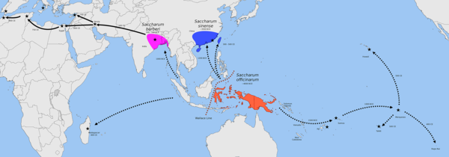
History of Sugarcane
Origins and spread
Cultivated in Southeast Asia around 8000 BC.
Spread to India, Persia, and the Americas.
Impact on Cultures
Integral to the development of economies and societies.
Notes:
Sugarcane has a storied past, originating around 8000 BC in the tropical regions of Southeast Asia. Over the centuries, it gradually spread across the globe, becoming a key agricultural product in various cultures.
Significant events, such as its introduction to the Americas during the Columbian Exchange, demonstrate sugarcane's impact on shaping economies and societies worldwide.

Slide 4
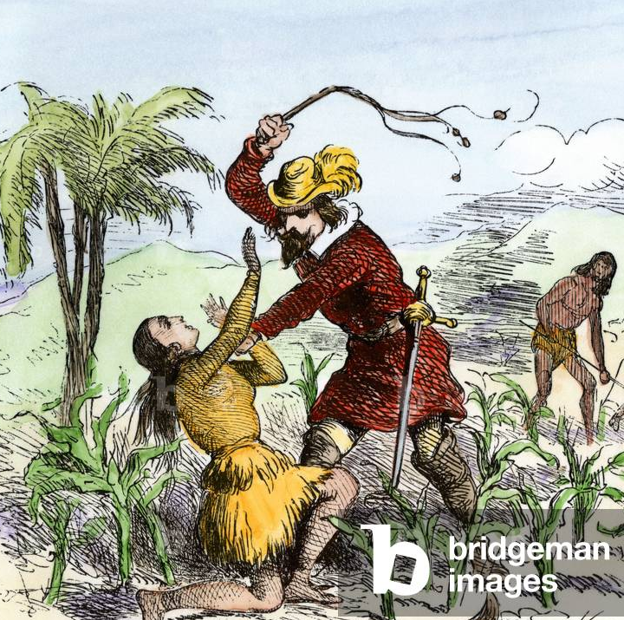
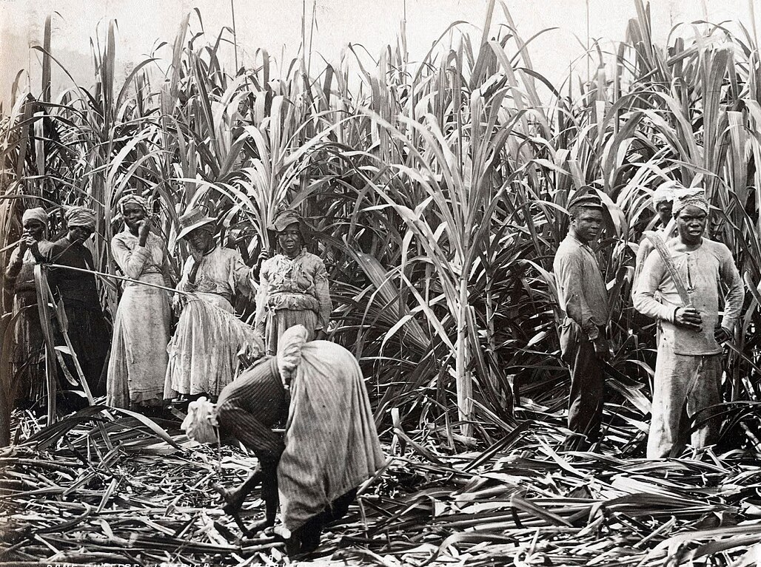
Colonial Context
Sugarcane in Colonialism
Became a major commodity driving the transatlantic slave trade.
Economic benefits for colonial powers.
Exploitation of Indigenous Communities
However, this prosperity came at a devastating cost, leading to the exploitation and marginalization of indigenous and enslaved communities.
Notes:
The colonial era marked a turning point for sugarcane. It became a driving force in the transatlantic slave trade, bringing significant economic benefits to colonial powers.
However, this prosperity came at a devastating cost, leading to the exploitation and marginalization of indigenous and enslaved communities. It's crucial to recognize these historical injustices as we discuss sugarcane's legacy.

Slide 5
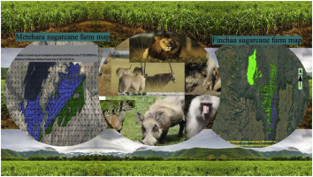
Ecological Impact
Environment Consequences
Deforestation, biodiversity loss, and soil degradation.
Need for sustainable practices in sugarcane farming.
Cultural Significance
Traditional knowledge and practices of indigenous communities.
Notes:
While sugarcane has greatly contributed to global economies, its cultivation has also resulted in severe ecological consequences, including deforestation and biodiversity loss.
These environmental challenges underscore the urgent need for sustainable practices in sugarcane farming. We must strive for solutions that protect our ecosystems while supporting agricultural productivity.

Slide 6
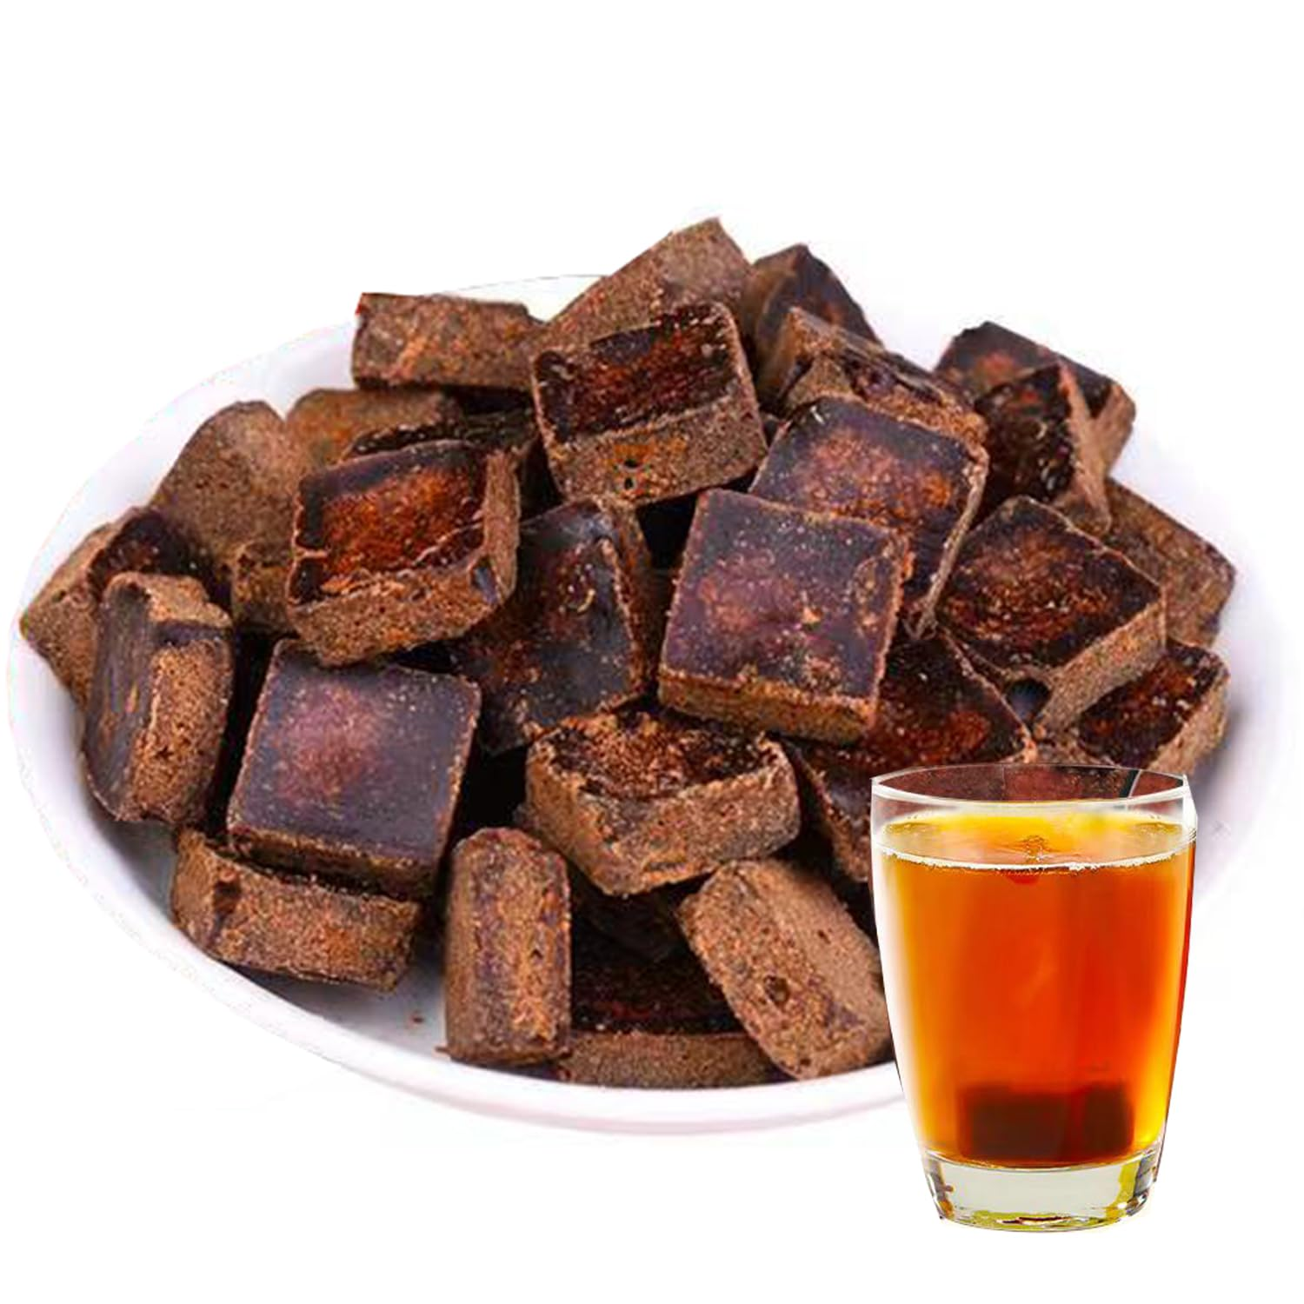
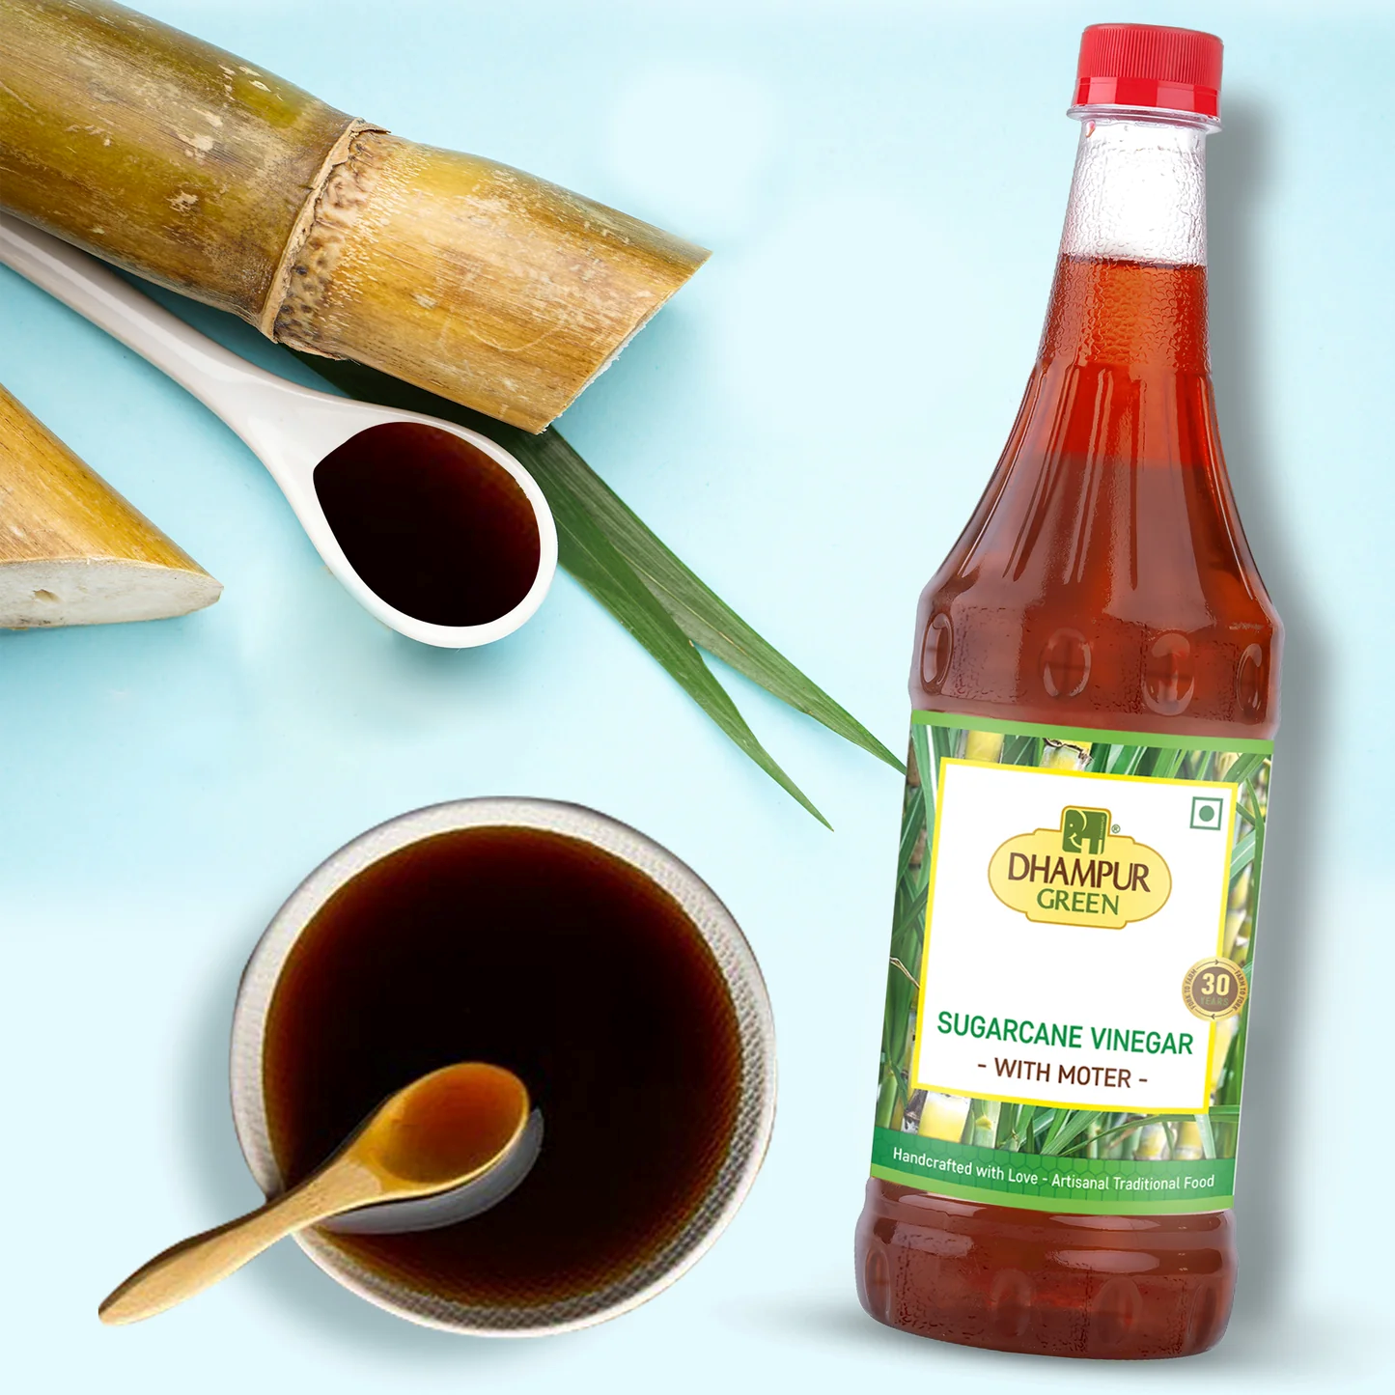
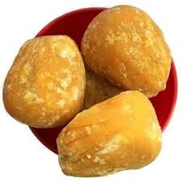
Equality, Diversity, and Inclusion
Traditional Uses
Indigenous communities utilized sugarcane in various cultural practices.
Recognition of Marginalized Voices
Acknowledging the impact of sugarcane production on these communities.
Notes:
Before colonial influences, indigenous communities cultivated sugarcane, utilizing it in various cultural practices.
This section emphasizes the importance of recognizing traditional knowledge and the deep cultural significance of sugarcane in these societies. Acknowledging marginalized voices is essential in creating an inclusive narrative around sugarcane's history.

Slide 7
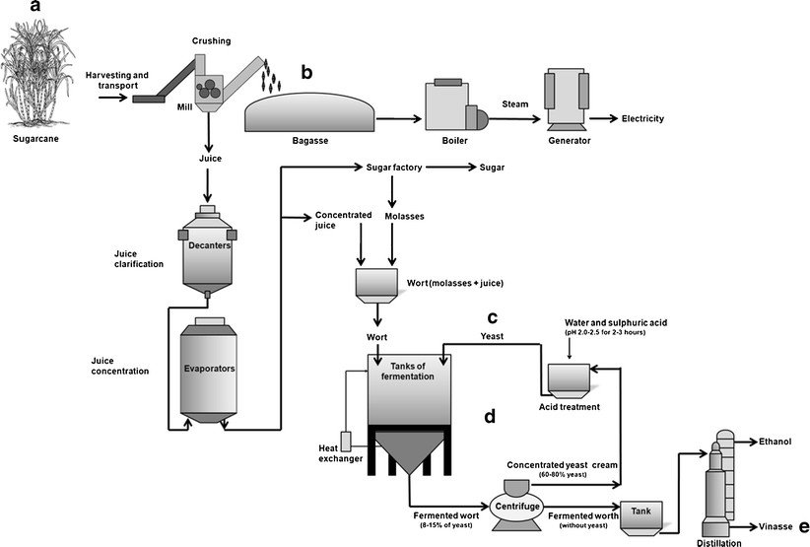
Contemporary Perspectives
Sustainability Practices
Adoption of eco-friendly agricultural techniques.
Fair trade certifications.
Innovative Solutions
Introduction of bioethanol production and sugar alternatives.
Notes:
As we move into the present, there is a growing shift towards sustainable practices in the sugarcane industry.
Modern farming techniques are evolving, with many producers adopting eco-friendly practices and obtaining fair trade certifications. These initiatives aim to support sustainable sugarcane production while ensuring fair compensation for farmers.

Slide 8
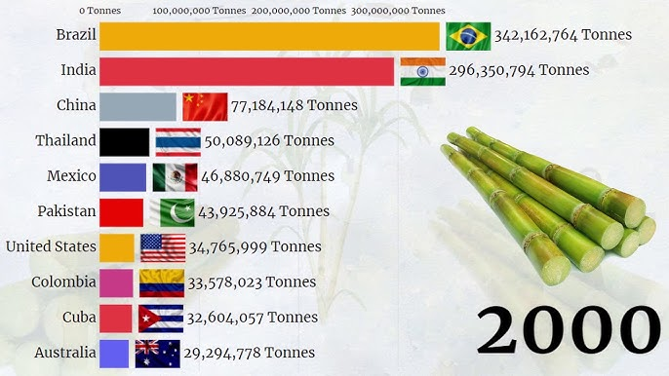

Sugarcane Production Today
Leading Producers
Brazil: the largest producer; India: the second.
Overview of the top 10 producing countries.
Future Directions
Focus on sustainability and reduced ecological impact.
Notes:
Today, Brazil stands as the leading producer of sugarcane, followed closely by India. In fact, India has transformed from a minor player in sugar production to the second-largest producer in the world.
As we look to the future, the focus on sustainability and reduced ecological impact will play a crucial role in shaping the industry's trajectory.

Slide 9
Conclusion
Key Takeaways
Sugarcane's rich history and its dual role in economies and ecosystems.
The importance of sustainable practices for future generations.
Thank You!
Notes:
In conclusion, sugarcane is not just a crop; it carries a rich history and dual role in economies and ecosystems.
The importance of sustainable practices cannot be overstated, as they are vital for the well-being of future generations. Thank you for your attention, and I welcome any questions or discussions you may have!

